Slide 1
Comprehensive VHDL Hamdi Abdelbagi Phone: (937) 830-7761 Email: abdelbagih1@udayton.edu

Slide 2
Design Entities
Aim
To become familiar with the main feature of the VHDL, particularly design entity
Topics covered
Entities and architecture
IEEE std_logic
Concurrent assignments and signals
Direct instantiation and port maps
Recommended layout
Names

Slide 3
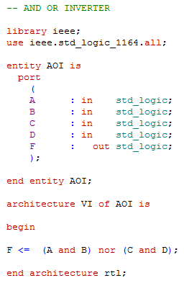
A Design Entity
Optional
VI

Slide 4
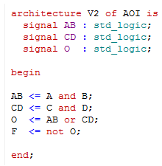
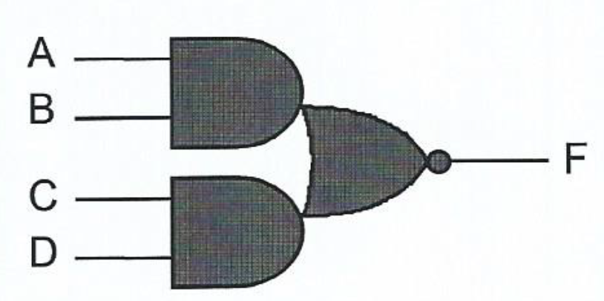
Optimized synthesis results will
be the same as before

Slide 5
std_logic & std_logic_vector

Slide 6
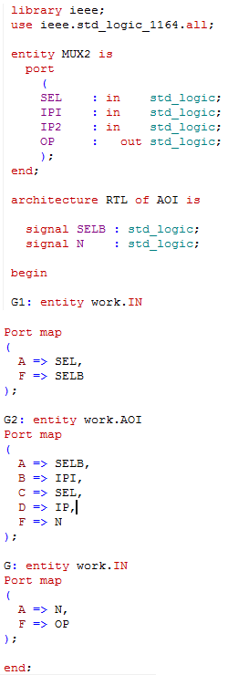
Instancing an Entity
A
F
A
B
C
D
F
A
F

Slide 7
Ports & Port Maps

Slide 8
Out port with read-Back

Slide 9
Vector Ports

Slide 10
Recommended layout

Slide 11
Names
You can not use these reserved identifiers as names:

Slide 12
Names

Slide 13
TCL Tool Control Language

Slide 14
Processes
Aim
To understand process statement
Topics covered
The process statement
Signal assignments
Delta delay
Inertial delay
TestBenches

Slide 15
Processes

Slide 16
The process statement
All processes start executing at time zero
Processes with a sensitivity list suspend at the bottom

Slide 17

RTL Processes

Slide 18
Signal Assignments
Delays are used to schedule events during simulation
Delays are ignored for synthesis

Slide 19
Delta Delay

Slide 20
The simulation cycle

Slide 21
Register Transfers

Slide 22
Inertial Delay

Slide 23
Generating a Pulse

Slide 24
Default Assignment

Slide 25
Test Bench

